Slide 1
BEST LOCATION FOR INDIAN RESIDENTS/Tourists IN BARCELONA
COURSERA CAPSTONE
IBM Applied Data Science Capstone
By :- Priyank Mehta

Slide 2
BACKGROUND
Barcelona is one of the world's leading tourist, economic, trade fair and cultural centres, and its influence in commerce, education, entertainment, sports, media, fashion, science, and the arts all contribute to its status as one of the major global cities. In 2016 about 59% of the inhabitants of the city were born in Catalonia and 18.5% coming from the rest of the country. In addition to that, 22.5% of the population was born outside of Spain, a proportion which has more than doubled since 2001 and more than quintupled since 1996 when it was 8.6% respectively 3.9%.

Slide 3
PROBLEM
Since immigration has increased there are lots of Indians who travel there but they don’t know which location will be most suitable for them. We wish to find a good neighbourhood for living in the city which has good Indian restaurants and other places like parks, grocery stores which might interest them.

Slide 4
PEOPLE BENEFITTED BY THE PROJECT
People of Indian Origin who want to settle in Barcelona and people who are going there for long trips will be most benefitted. Also, tourist can use this to find neighbourhoods which will have quick access to Indian stores and veg food available. Vegetarian people are most benefitted as its difficult to find suitable food in such countries.

Slide 5
DATA ACQUISITION AND CLEANING
Data is mostly collected from Four-square and web scraping.
List of Neighbourhoods will be collected using web Scraping the following link:
https://en.wikipedia.org/wiki/Category:Neighbourhoods_of_Barcelona
For each neighbourhood, we will use Geocoder Python to get its coordinate.
Venues from Four-Square will be used. Web scraping will be used for other data which isn’t available on Four-Square.
Data will be cleaned and organized then displayed in forms understandable to basic users.
Machine learning techniques will be used to classify and segment neighbourhoods.
We have used K-Means Method here for the sake of simplicity.
This will help decide which one is most suitable for the person’s needs.

Slide 6
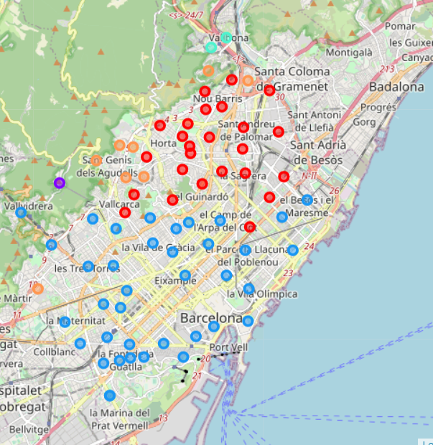
OBSERVATION AND DISCUSSION
The image shows different Clusters formed with the help of different colours throughout the city.
The areas are segmented using K-Means.
Cluster shows similar areas grouped together.

Slide 7
CONCLUSIONS
So after the analysis we have classified different areas based on Venues they have-Basically, we identified different clusters
Cluster 5 is most suitable for families- Pedralbes ,Sant Genís dels Agudells ,Torre Baró being the most suitable
Cluster 2 is most suitable for Bachelors - Fort Pienc, Sants,Sants-Badal being the most suitable
General good places for living are - El Congrés i els Indians,Can Peguera,Bon Pastor,Sant Andreu de Palomar,Vallvidrera,La Guineueta
For Specific places with Indian Restaurants - Les Tres Torres, Diagonal Mar i el Front Marítim del Poblenou

Slide 8
LIMITATIONS AND FUTURE SCOPE
We need to incorporate more data to find what kind of population lives in what region.
Also, we haven’t considered distance from workplace in our program.
We can add these and few small more details to make this program more accurate and useful.
We can also expand this to make this useful for people of different religions, countries etc.

Slide 9


